Slide 1

RUNGTA COLLEGE OF DENTAL SCIENCES & RESEARCH
TITLE OF THE TOPIC-
MYOFUNCTIONAL APPLIANCE GENERAL PRINCIPLES
DEPARTMENT OF ORTHODONTICS AND DENTOFACIAL ORTHOPAEDICS

Slide 2
Specific learning Objectives
CORE AREAS | DOMAIN | CATEGORY
INTODUCTION | AFFECTIVE | DESIRE TO KNOW
CLASSIFIACTIONS | COGNITIVE | MUST KNOW
PRINCIPLES | COGNITIVE | MUST KNOW
EFFECTS OF FUNCTIONAL APPLIANCES | COGNITIVE | NICE TO KNOW
INDICATIONS & ADVANTAGES | COGNITIVE | MUST KNOW
LIMITATIONS | COGNITIVE | NICE TO KNOW

Slide 3
CONTENTS
INTRODUCTION
CLASSIFICATIONS
PRINCIPLES
EFFECTS OF FUNCTIONAL APPLIANCE
INDICATIONS & ADVANTAGES
LIMITATIONS

Slide 4
INTRODUCTION
Functional appliances are defined as loose fitting or passive appliance, which harness natural forces of the oro-facial musculature that are transmitted to the teeth and alveolar bone through the medium of the appliance.
Myo-functional appliances as they are sometimes referred to appliances that depend upon the oro-facial musclature for their action.
In earlier days these terms used synonymously.

Slide 5
introduction
Definition –
Proffit – “ functional appliance is one that changes the posture of the mandible, holding it open or open & forward. Pressures created by the stretch of the muscles & soft-tissues are transmitted to the dental & skeletal structures, moving teeth & modifying growth.”

Slide 6


EVOLUTION OF
FUNCTIONAL APPLIANCES

Slide 7
evolution
1. NORMAN KINGSLEY :
1879 – first to use the forward positioning of the mandible in orthodontic therapy
“bite Jumping ” appliance .
He used forward positioning of the mandible in orthodontic treatment.

Slide 8
evolution
2. PIERRE ROBIN (1902):
Functional device for jaw bone expansion & glossoptosis therapy
His appliance- The MONOBLOC influenced muscular activity by changing the spatial relationship of the jaws.
3.VIGGO ANDRESEN(1909):
Introduced the activator.
Appliance later modified by karl Haupel.
The herbst appliance a fixed functional appliance was introduced in 1905 by Emil Herbst.

Slide 9
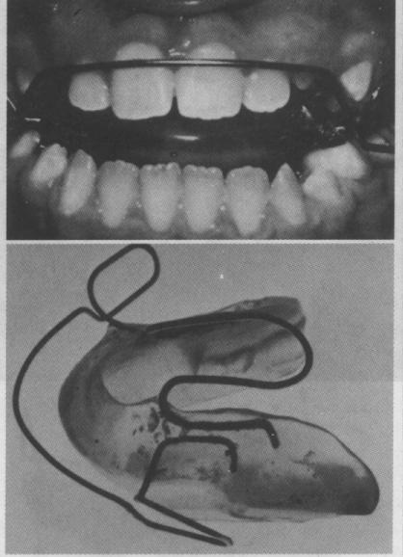
evolution
WILHELM BALTERS – in an effort to treat class 2 malocclusion characterized by deficient mandibles, began to modify Andresen’s activator. He gave it the name BIONATOR.

Slide 10
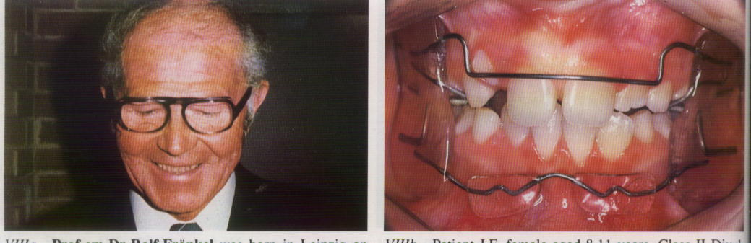
evolution
ROLF FRANKEL (1957):
Designed the functional regulator.
The appliance was designated as FR-1, FR-2, and FR-3 for treating class 1, class 2 and class 3 malocclusions.

Slide 11
CLASSIFICATION

Slide 12
GRABER’S CLASSIFICATION
classification
GROUP I:
Transmit muscle force directly to teeth
Ex. Inclined planes
Oral shields/screens
GROUP II:
activating attached & associated musculature
Force not only to teeth, also maxilla & mandible
Ex. Activator, bionator

Slide 13
classification
GROUP III:
vestibular positioned appliances with isolated support from tooth/tissue.
Ex. Frankel Function Regulator
lip bumper.

Slide 14
classification
I. MYOTONIC:
depend on muscle mass for their action
II. MYODYNAMIC:
Depend on the muscle mass for their action

Slide 15
PROFFIT’S CLASSIFICATION
classification
I. PASSIVE TOOTH-BORNE APPLIANCES:
No intrinsic force generating capacity (screws/springs)
Soft-tissue stretch & muscular activity
Ex. Activator
Bionator
Twin Block
Herbst appliance

Slide 16
classification
II. ACTIVE TOOTH-BORNE APPLIANCES:
Include expansion screws/springs to move teeth
Activator & modifications bearing active components
Ex – Expansion activator
Orthopedic corrector
Sagittal appliance
III. TISSUE-BORNE APPLIANCES:
Located in vestibule
Free of contact with bone/teeth
Ex. Function Regulator

Slide 17
classification
A. REMOVABLE FUNCTIONAL APPLIANCES
B. FIXED FUNCTIONAL APPLIANCES
1. FLEXIBLE FFA –
Jasper Jumper
Amoric Torsion Coils
Adjustable Bite Corrector
2. RIGID FFA –
Herbst appliance
Cantilevered Bite Jumper
MALU Herbst appliance
3. HYBRID FFA –
Calibrated Force Module
Eureka spring
Forsus FRD

Slide 18
......How??
Principles of functional appliances

Slide 19
principles
2 principles –
FORCE APPLICATION
FORCE ELIMINATION

Slide 20
principles
FORCE APPLICATION –
Compressive stress & strain on structures
Primary effect – alteration of form
Secondary effect – adaptation in function
Ex. – all active fixed & removable appliances

Slide 21
principles
FORCE ELIMINATION (Myofunctional) –
Abnormal & restrictive environmental influences eliminated – optimal development
Primary effect – rehabilitation of function
Secondary effect – adaptation of form according to function
Elimination of pressure by – viscoelastic displacement of periosteum – tensile strain – bone formation
Ex. – Functional regulator, lip bumper, vestibular screen

Slide 22
principles
The success of functional appliance therapy depends on
1. Patient compliance
2. Timing of treatment
3. Neuromuscular response - Poliomyelitis & cerebral palsy

Slide 23
principles
2. DIRECTION:
For tooth movement – CONSISTENT
Functional forces – stimulate tooth movement in one direction
When appliance not worn – forces of intercuspation & occlusion – drive teeth in opposite direction – ‘JIGGLING’
Eliminate
Does not occur with full-time/bonded appliances
3. MAGNITUDE:
Small in functional therapy
Difficulty in wearing appliance if strain too great.

Slide 24
……..What??
Effects of functional appliances

Slide 25
effects
FORCE APPLICATION–TYPE (prototype – Activator)
Effects on Mandible:
Increased amount of condylar growth
Remodeling of the articular fossa – anterior
Incremental increases in growth of mandible
Combination of these effects - permanent anterior displacement of the mandible.
Condylar growth – POSTERIORLY directed – DOWNWARD & BACKWARD mandibular rotation

Slide 26
effects
2. Effects on Maxilla:
Inhibit horizontal maxillary growth
Increase posterior maxillary height
3. Effects on Dentition:
Maxillary incisor lingual tipping
Mandibular incisor labial tipping
Inhibits vertical maxillary dentoalveolar development
Encourages vertical mandibular dentoalveolar development

Slide 27
effects
4. Effects on Soft tissue:
Upper lip retrusion
Anterior positioning of – soft-tissue pogonion

Slide 28
effects
FORCE ELIMINATION–TYPE (prototype – Functional Regulator)
1. Effects on Mandible:
Forward displacement of pogonion & point B.
Increase in mandibular length
2. Effects on Maxilla:
No horizontal effects on maxilla
Downward & backward rotation

Slide 29
effects
3. Effects on Dentition:
Lingual tipping of maxillary incisors
Prevents mesial migration of upper molars & not extrusion
4. Effects on Soft-tissue:
Improvement in lip position
No change in convexity of profile
5. Effects on Arch width:
Expansion of arch-width – more in maxilla

Slide 30
INDICATIONS
Expansion & sagittal correction of jaws
Treatment timing – maxillary incisors more vulnerable to fracture & loss
Eliminate functional aberrations
Train perioral musculature – optimal development
Help mandible attain most favorable growth increments & directions
Help eliminate arch-length deficiencies – normalizing functional matrix & functional spaces
Accelerate trend to eliminate abnormal muscle pattern at a critical time

Slide 31
Advantages of functional appliances
It enables elimination of abnormal muscle function thereby aiding in normal development.
Treatment can be initiated at an early age. It is most often started in the mixed dentition period.
As the treatment is started at an early age, psychological disturbances associated with malocclusion can be avoided.
These appliances are mostly fabricated at the dental laboratory. Thus less chair side time is spent which enables more patients to be treated.

Slide 32
The frequency of the patient’s visit to the orthodontist is less than in case of fixed or removable appliances.
They do not interfere with oral hygiene maintenance.
Most functional appliances are worn during the night. Thus patient acceptance is good.

Slide 33
Limitations Of Functional Appliances
They cannot be used in adult patients in whom growth has ceased.
They cannot be used to bring about individual tooth movement.
Most functional appliances are dependent on the patient for timely wear. Thus patient cooperation is essential for the success of the treatment.
They may require pre-functional orthodontic tooth movement for correction of minor local irregularities that may interfere with the functional therapy.
Fixed appliance therapy may be required at the termination of treatment for final detailing of the occlusion.

Slide 34
SUMMARY
The ideal requirements of a functional appliance are:
• It should be comfortable and acceptable for the patients.
• It should promote better compliance.
• It should offer good range of mandibular movements.
• It should be simple and inexpensive.
• It should be easy to ft.
• It should be adaptable to both Class II and Class III malocclusions.
• When used with fixed appliances, it should not cause breakage.
• It should be usable in both mixed and permanent dentitions.
• It should provide good results with minimal patient cooperation.

Slide 35
REFERENCES
Textbook of Orthodontics – Gurkeerat Singh, Jaypee Brothers; 2nd Edition
Orthodontics – The Art and Science, S.I Bhalajhi, AryaMedi Publishing; 7th Edition
Textbook of Orthodontics – Sridhar Premkumar, Elsevier; 1st Edition
Orthodontics: Diagnosis and Management of Malocclusion and Dentofacial Deformities – O.P Kharbanda, Elsevier; 1st Edition

Slide 36
Question & Answer Session

